Slide 1
Characteristics of Populations

Slide 2
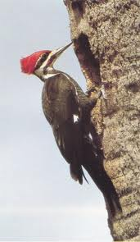
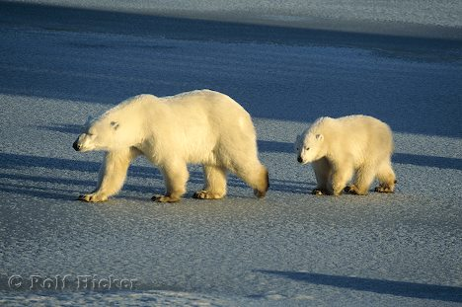
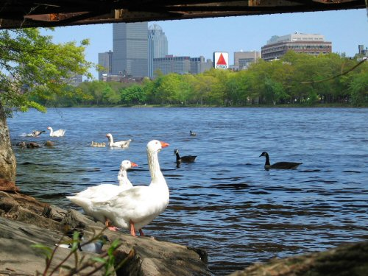
Habitat: the place where an organism lives
Species: organisms that resemble one another (in appearance, behaviour, chemistry and genetic makeup) and that have the ability to interbreed with each other under natural conditions to produce viable offspring.
Population Size: the estimated total number of organisims

Slide 3
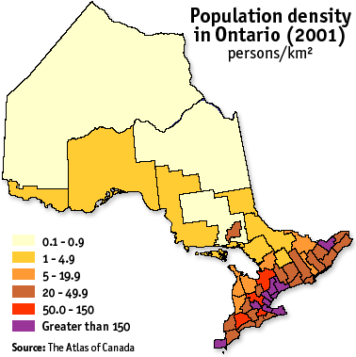
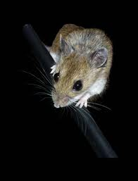
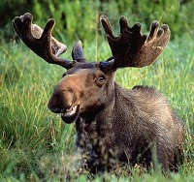
Population Density (D) is calculated by dividing the population size or number of individuals (N) by the space occupied by that population (S).
Usually smaller organisms have much greater population densities than larger organisms. (Ex. 350 field mice per hectare in Algonquin Park vs. 0.8 moose per hectare)
D = N
S

Slide 4
Crude Density: pop density measured in terms of # of organisms of the same species within the total area of the entire habitat.
Ecological Density: pop density measured in terms of the # of individuals of the same species per unit area or volume actually used by the individuals.

Slide 5
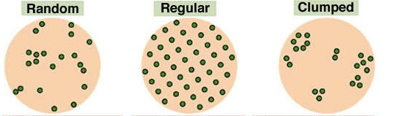
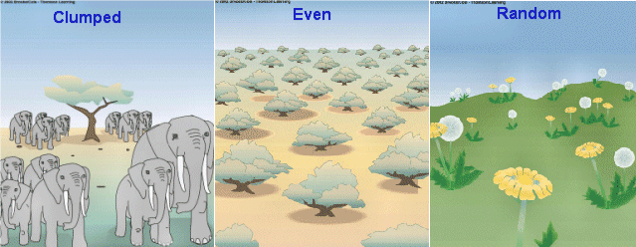
Population Dispersion
the pattern in which individuals are dispersed throughout a specific area.
There are 3 general types:

Slide 6
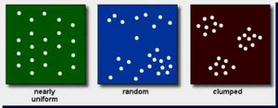
Clumped Dispersion: organisms are densely populated in areas of the habitat with favourable conditions for survival, usually around resources (most populations exhibit this...cattails growing at the edges of ponds, fish swimming in schools...)

Slide 7
Uniform Dispersion: individuals are evenly distributed throughout the habitat. Occurs when individuals set up territories (eg. Penguins).

Slide 8
Random Dispersion: occurs when the habitat is particularly uniform and interactions with other members of the same species do not affect distribution. This is fairly rare in nature, eg. some tropical trees.

Slide 9
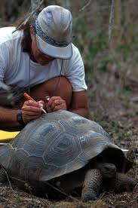
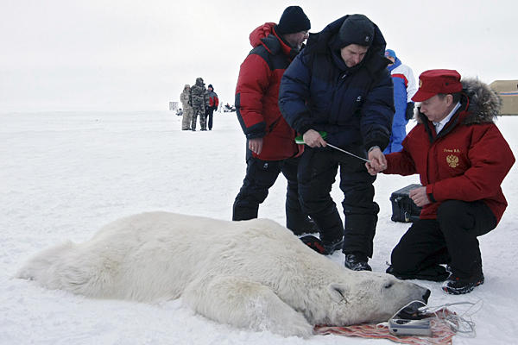
Mark-recapture Sampling
A common sampling technique for mobile or dangerous populations is mark-recapture.
Biologists trap/tranquilize/catch a number of individuals of a population, mark them and then release them back into their habitat.
A short time later they catch a second sample of the population and use the ratio of the marked recaptures to the unmarked captures to estimate the population size.

Slide 10
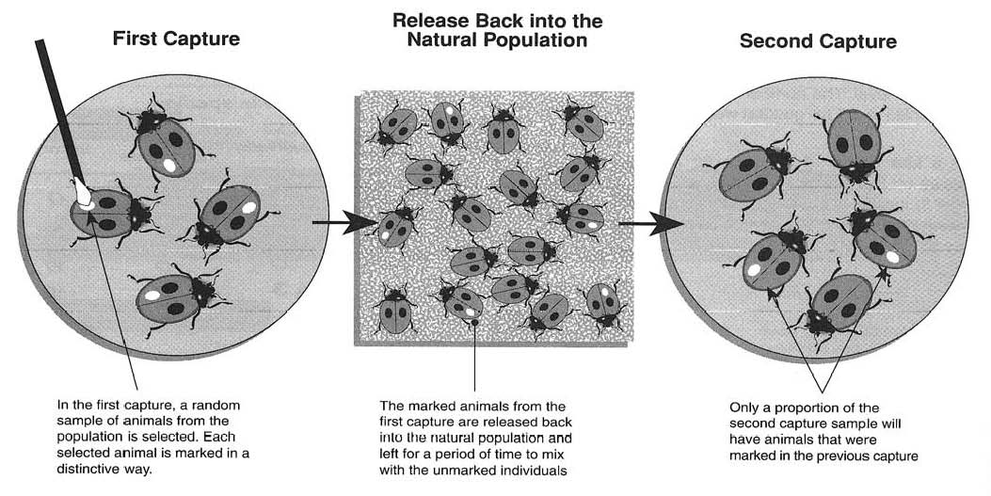
Example

Slide 11
The marking must not :
harm the individual,
prevent it from going about daily activities or
make it more easily caught a second time.

